Slide 1
UK Progress towards Net Zero
For Farnham U3A Climate Change Group
Stewart Edge September 2023

Slide 2
Contents
Overview of UK in World
What Commitments have UK Made?
Progress against Commitments

Slide 3
Overview – UK in the world
There is a problem!!!
COP26 (in UK) maintained that 1.5degC temperature rise was still possible
But overall Country Commitments failed to meet this fully
Let alone actual plans in place by Countries
UK only about 1% of Worldwide emissions
(4.5% of historical cumulative worldwide)
China 29% and growing
USA 14%
UK Irrelevant?!
BUT – moral responsibility; and opportunities
Notes:
Problem – 40 deg in 2022; UK’s warmest ever year
Glasgow NDC’s for Net Zero 1.8deg; Pledges by 2030 only 2.4deg
And COP27 did not ‘ratchet up’ the NDC’s

Slide 4
Emissions By Country
Notes:
These are ‘in country’ emissions – UK much worse when manufacturing imports taken into account
25% of world’s consumption from those less than UK

Slide 5
Since 2000 their should be no debate about whether Climate Change is happening

Slide 6
…..and this is the case in the UK

Slide 7
UK Structures and Processes
Climate Change Committee
Genuinely professional (and independent) advisory group
6th Carbon Budget Dec 2020
Annual Report on Progress Jun 2023
Actual Government Policy
Department for Energy Security and Net Zero
Carbon Budget Delivery Plan March 2023
Other groups and influences
Other Political Parties, Extinction Rebellion
Companies, individuals……
Notes:
Annual Report on progress ……..measures progress towards NDC (2030) and 6th CB (2035)
Carbon Budget Delivery Plan response to High Court Challenge that government not meeting its legal obligations

Slide 8
UK NDC at COP26
68% fall in emissions from 1990 levels by 2030
In 2022 46% below 1990 levels
Target Implies RATE of reduction outside power sector must almost quadruple
Plans will meet 50% of reductions needed from 2022 levels
Including policies with some risks this rises to 80%
But plans do not achieve final 20%
Fossil fuel expansion inconsistent with ‘leading’ internationally
Notes:
The UK NDC was seen at COP26 as reasonable though not yet sufficient
COP26 did have UK leading internationally …….. But no longer doing so.

Slide 9
Climate Change Committee 2023 Report on Progress
‘Confidence of CCC that UK will meet its medium term targets has decreased in the last year’
Our response to the recent fossil fuel price crisis did not embrace the rapid steps that could have been taken to reduce energy demand and grow renewable generation.
We have backtracked on fossil fuel commitments, with the consenting of a new coal mine and support for new UK oil and gas production – despite the strong wording of the Glasgow Climate Pact.
And we have been slow to react to the US Inflation Reduction Act and the EU’s proposed Green Deal Industrial Plan, which are now a strong pull for green investment away from the UK.
Notes:
When doing summary for this group in 2021, I remember Lord Deben (John Selwyn Gummer) the CCC chairman being quite positive about Government plans – with exception of Agriculture / Land Use – NOW complete change of tone.

Slide 10
UK Emissions over time by sector - Actual & future Carbon Budget Pathway

Slide 11
Required reduction ex electricity supply

Slide 12
Progress against key indicators
Notes:
Green on track cf CB; Orange slightly off track; red significantly off track; white too early to say; light grey
No nemchmark; dark grey data not reported

Slide 13
Comments on Progress by Sector Follow
Includes key targets / commitments
Climate Change Report key concerns
(Additional observations in brackets ……in light of previous discussions in this group)

Slide 14
Progress – General across sectors
Insufficient progress on reducing demand
Including during energy cost crisis
Policies needed to empower and support people to make low carbon decisions: communication, engagement and fiscal levers
Home energy
Diet
Reducing air and car travel
Insufficient progress on building skills
Notes:
Even when every extra gas unit used cost HMG direct money, no national campaign to reduce demand

Slide 15
Progress - Transport
SURFACE (23% of 2022 emissions)
Phase out of new petrol / diesel cars by 2030; of new hybrids by 2035
Progress for 2030 on cars appears OK ………though
Delay in developing ‘zero-emissions vehicle mandate’ (requiring manufacturers to sell rising % of Zero E Vehicles) seen as serious omission
Insufficient progress on vans
Insufficient chargepoints – deployment needs to double; price uncertainty
No incentives to reduce size and weight of cars
No commitment to shifting demand away from cars
Future for Zero Emissions HGV’s seen as UK opportunity not being taken
AIR (7% of 2022 emissions)
Failure to establish ‘no new net UK airport expansion’ policy
2023 Spring Budget confirmed low Air Passenger Duty for internal flights (+ nothing on frequent flyers)
Notes:
Modal shift was previously 5 out of 61 MTCO2 reduction by 2035
8% lower than 2019 ……new steady state ?
Chargepoints need to double THIS YEAR
AIR 25% growth between 2018 and 2050 IS allowed in 6th Carbon Budget Pathway, but UK total capacity could accommodate this ……..
SAF is assumed as basis for allowing continuing aircraft growth ….

Slide 16
Progress - Electricity Supply (11% 2022 emissions)
Good progress to date since 1990’s
Target decarbonisation of electricity supply planned for 2035
But strategy of how missing …esp.how to cope with intermittency of wind / solar
Though grid battery storage on 5 year targets
BUT
Insufficient progress on Solar
(Not allowing new on-shore windfarms)
(Network (grid) strategy seems non-existent – have started to see commissioning of off-shore windfarms limited by network connections)
Notes:
Progress to date…..elimination of coal (using Carbon Pricing); off shore wind
On shore windfarms - not planned in Balanced Pathway so doesn’t show as real failing
Off shore 2.7GW in 2022 cf rate 4.5 needed to deliver 50GW by 2030
Solar IS down 0.7GW in 2022 cf 4.3GW needed to meet 2035 target

Slide 17
Progress – Buildings (17% 2022 emissions)
Energy efficiency measures inadequate
New build regulations insufficient
Plans for Insulation of existing buildings inadequate
Last Green Deal withdrawn with poor take-up
Government planning to determine strategy for role of hydrogen in home heating by 2026
But this is blocking progress on low carbon heating roll out NOW
600,000 heat pumps per year planned by 2028
BUT currently 1/9 of rate needed to meet target
Costs too high
Insufficient training of installers
Comparisons with elsewhere in Europe stark
Alignment of gas and electricity prices planned (by Mar 2024)
-
Notes:
Green deal ….loans too expensive; bureaucratic delays; insufficient skills
Insufficent skilled retrofitters
Off gas grid buildings should be going to heat pumps NOW

Slide 18
Progress – Industry 14% 2022 emissions
Note Challenges /Risks re decarbonisation of industry
Industry locates elsewhere where less control of emissions – Carbon Border Tax needed.
Industry locates elsewhere because other governments give more support (eg USA, EU)
Carbon Capture and storage (UK uniquely positioned to make use of this)
9MTCo2e by 2035 – 20% of industry reductions
£20B new funding over 20 years
BUT risks that will not deliver in time
Low Carbon hydrogen pilot projects in progress
BUT Strategy (esp for distribution and storage for dispersed sites) missing; and Incentivising Hydrogen unclear
(Electric Car manufacturing – 1 UK battery plant(only) just started : British Volt failure)
Policy Gaps
Industrial electrification (esp steel) – price, network and technology issues
Off road mobile machinery – no strategy Small and dispersed industrial sites – no strategy / timeline
Resource efficiency Emissions Trading Scheme future details not established
Data availability weaknesses
Notes:
Note because of imports UK is actually much more of a user of manufacturing than represented here…
Producer Responsibility for packaging Uk 2024; drinks container deposit scheme 2025

Slide 19
Progress - Agriculture and Land Use 11% 2022 emissions
Framework planned for Summer 2023 not yet published
Agriculture / food security / recreation / nature recovery / climate change mitigation ………..
Tree planting, peat restoration insufficient – needs scaling up
Progress – Waste (6% 2022 emissions)/ Biomass
Missing strategies
Progress – Fuels Supply (7% 2022 emissions)
Cumbrian Coal approval
New North Sea Licences
Notes:
Agriculture ……..plans such as they are depend (1/3) on technology innovation
no progress on demand changes (which could reduce methane and release land for sequestration)
recent trade deals haven’t required environmental constraints on imports
EfW emissions growing – moratorium needed
Cumbrian
North Sea CCC objected because of direct effect on GG emissions – arguing that effect on UK prices would be marginal.

Slide 20
Overall policies will only meet 50% - 80% of reductions needed
Notes:
Based on Govt Carbon Delivery Plan (which only appeared in response to High Court Challenge)

Slide 21
Shortfall v NDC target particularly in Industry, Buildings and Surface Transport

Slide 22
END

Slide 23
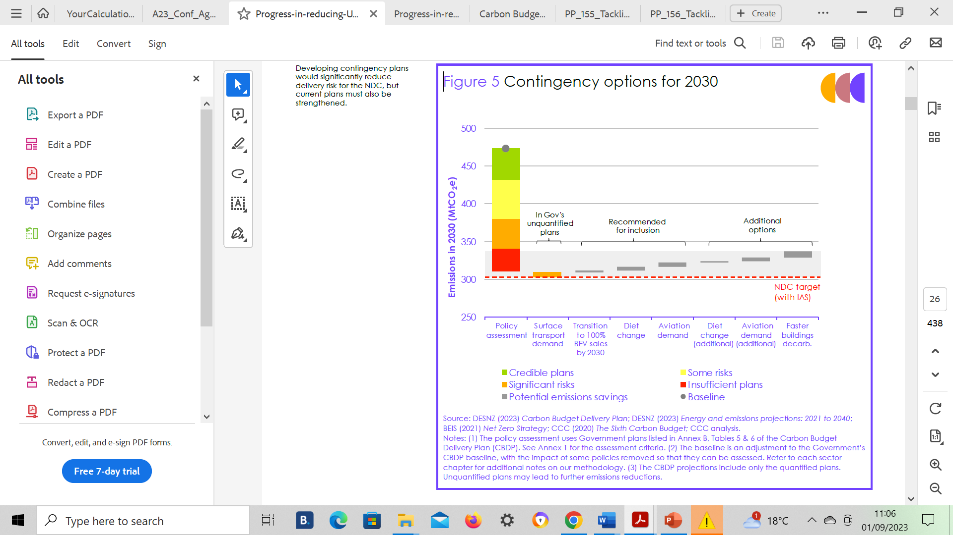

Slide 24
Policy Scorecard

Slide 25
Demand
Planning system problems
insights and lessons from the UK Climate Assembly.??? Page 14 eg tax frequent flyers and get rid of SUV’s

Slide 27
The Government’s decarbonisation framework is currently missing
coherent plans to mitigate the delivery
risks to meeting the UK’s 2030 NDC and
the Sixth Carbon Budget.
The Government’s decarbonisation framework is currently missing coherent plans
to mitigate the delivery risks to meeting the UK’s 2030 NDC and the Sixth Carbon
Budget. The current strategy has considerable delivery risks due to its over-reliance
on specific technological solutions, some of which have not yet been deployed at
scale. This lack of balance carries considerable and increasing risks to meeting the
emissions targets.
There is already a clear case for demand-side policies to reduce emissions. These
should be implemented now, as a core part of the decarbonisation strategy,
especially on home energy use, shifting to healthier and more sustainable diets,
and reducing air and car travel. Further strengthening of policy in these areas may
be required subsequently given the risks of shortfalls in delivery elsewhere.

