Slide 1
U3A Sustainable Energy Group
Agriculture and Food – focus on Britain
Andrew Partridge
September 2023

Slide 2
Sources
Philip Oliver’s presentation Feb 2023
DEFRA Agriculture in the United Kingdom data sets, July 2022
Nature Friendly Farming Network: Rethink Food – A Plan for Action, Oct 2022
Green Alliance: Shaping UK Land Use, Jan 2023
WWF: The Future of Feed, June 2022

Slide 3
UK annual consumption (millions of tons)
From: DEFRA Agriculture in the United Kingdom data sets, July 2022
Notes:
https://www.gov.uk/government/statistical-data-sets/agriculture-in-the-united-kingdom
Chapter 7 (Crops); Chapter 8 (Livestock)

Slide 4
100%
100%
From: DEFRA Agriculture in the United Kingdom data sets, July 2022
Notes:
https://www.gov.uk/government/statistical-data-sets/agriculture-in-the-united-kingdom
Chapter 7 (Crops); Chapter 8 (Livestock)
Seem to be net exporter of raw potatoes, but import a lot of processed potatoes (eg frozen chips)
Fruit: 16% home produce; 28% from EU; 55% ROW

Slide 5
UK agricultural land use
From: DEFRA Agriculture in the United Kingdom data sets, July 2022
Notes:
https://www.gov.uk/government/statistical-data-sets/agriculture-in-the-united-kingdom
Chapter 2, Table 2.1
UK Utilised Agricultural Area is about 70% of UK total area (from source above)

Slide 6
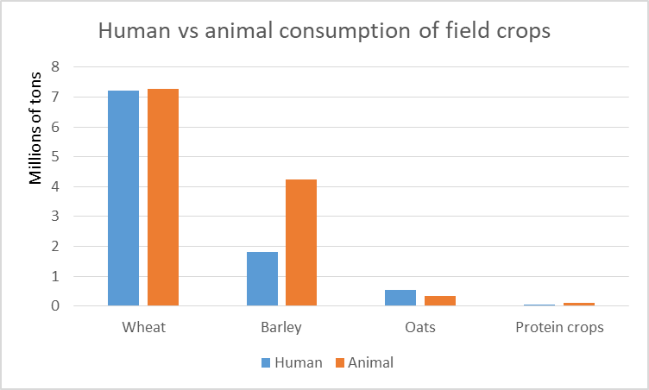
Use of crops – human and animal use compared
From imports
From: DEFRA Agriculture in the United Kingdom data sets, July 2022
Notes:
https://www.gov.uk/government/statistical-data-sets/agriculture-in-the-united-kingdom
Chapter 8 – Crops; 5-year average calculated 2017-2021
Human use of barley: brewing
‘Other’ use of wheat: brewing
Amount of wheat for human consumption that is home-grown – derived from Agriculture and Horticulture Development Board (AHDB) ‘Supply and Demand’ publication Sept 2022. 5-year average figure used. This agrees closely with the gov.uk DEFRA figures if ‘other’ in the latter is assumed to be for brewing and all sourced from the UK.
Amount of wheat for animal consumption that is home-grown is from AHDB publication. DEFRA spreadsheet does not specify this.

Slide 7
Notes:
WWF report The Future of Feed, June 2022 https://www.wwf.org.uk/sites/default/files/2022-06/future_of_feed_full_report.pdf
p7

Slide 8
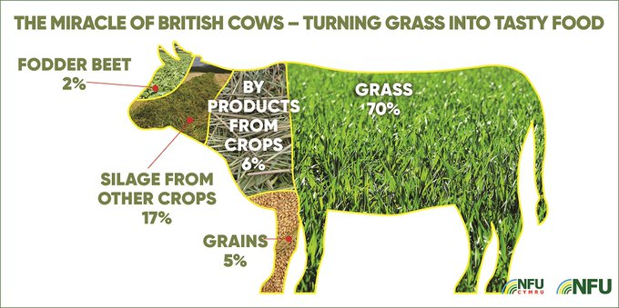
British livestock feed use – from NFU
Notes:
https://www.fwi.co.uk/news/environment/farmers-accuse-bbc-of-bias-over-prime-time-anti-meat-programme

Slide 9
Reasons for animal consumption of arable crops
Current human consumption needs met
Need for ‘break crops’ – eg oilseed rape, field beans, temporary pasture
Grains rejected for human consumption (eg inadequate protein)
Prohibition of using food waste and scraps for pig feed following ‘serious biosecurity breaches and human health hazards inc BSE’
Fast-maturing breeds favoured by intensive farming practices require high-protein diet
Notes:
Rejected for human consumption – from WWF report p24
https://www.wwf.org.uk/sites/default/files/2022-06/future_of_feed_full_report.pdf
‘For example, a significant proportion of cereals currently used in animal feed are grade-outs that
do not meet supply chain quality grading standards. This includes, for example,
wheat that does not have a high enough proportion of protein to meet the demands
of bread manufacturers. These standards are to some degree subjective - low
protein content does not necessarily mean that wheat cannot be used to make
bread, just that there is not sufficient market demand for this kind of wheat. ‘
Prohibition of using food waste for pig-feed: WWF report, p10

Slide 10
Sources of beef consumed in UK
Notes:
https://www.gov.uk/government/statistical-data-sets/agriculture-in-the-united-kingdom
Chapter 7 - Livestock

Slide 11
UK Meat Consumption
Notes:
Nature Friendly Farming Network report: Rethink Food – A Plan for Action Oct 2022 p25
https://www.nffn.org.uk/wp-content/uploads/2022/10/nffn_report_final.pdf

Slide 12
UK livestock - trends
1980
2020
1990
2020
Home produced
Dairy
1980
Beef
2020
1990
Imported (from EU)
Notes:
https://www.gov.uk/government/statistical-data-sets/agriculture-in-the-united-kingdom
Chapter 8 (Livestock)

Slide 13
WWF report recommendations
Notes:
WWF report The Future of Feed, June 2022 https://www.wwf.org.uk/sites/default/files/2022-06/future_of_feed_full_report.pdf
P12,13

Slide 14
WWF report recommendations
Adopt as policy a move to reduce human meat consumption – ‘less but better’
Bring ‘low opportunity cost’ feed options into mainstream policy discussion
Significantly reduce pig and poultry populations; move away from intensive farms (reducing nitrogen pollution and damage to aquatic ecosystems),
Retain grazing livestock (ie cattle and sheep) – key to a low opportunity cost system - but in reduced numbers; move to breeds able to spend most of the year outside
Reconsider use of food-waste as animal feed, as in parts of Europe
Avoid a ‘one-dimensional’, greenhouse-gas-based, approach to food policy
View from horticulture sector:
Horticulture should receive gov’t support as other agriculture sectors do
Especially if eg investment in renewable energy for glasshouses is to occur
Currently excessive pressure from supermarket buyers
Notes:
WWF report The Future of Feed, June 2022 https://www.wwf.org.uk/sites/default/files/2022-06/future_of_feed_full_report.pdf
Most items p17; grazing livestock key to low opportunity cost feed system p10; nitrogen and aquatic impact of intensive poultry and pig farms p14
Dangers of ‘one-dimensional approach’ (p17): ‘For instance, some dietary sustainability recommendations prioritise poultry meat consumption because of its low greenhouse gas emissions per gram of protein. The low opportunity cost feed framework turns this on its head, highlighting the pressures that intensively-produced poultry places on the environment locally and globally.’
Horticulture points from Sustain – Sustainable farming campaign blog – 23 Feb 2023 - https://www.sustainweb.org/blogs/feb23-glasshouse-half-empty/

Slide 15
Further points from WWF report
Move towards agroecological farming with more ‘slack’ to aid biodiversity
Avoid large-scale conversion of pasture to arable land (grassland a major reservoir of carbon)
From Green Alliance report – Shaping UK Land Use
Note: Use of low-opportunity-cost-fed livestock increases nutritional output of land over a purely vegan approach, as animals are consuming material that humans cannot
Notes:
WWF report The Future of Feed, June 2022 https://www.wwf.org.uk/sites/default/files/2022-06/future_of_feed_full_report.pdf
Grassland a carbon reservoir p27; benefits over purely vegan approach – p8; agroecological approach – p14

Slide 16
GHG contributions per 100 grams of protein
Notes:
From Philip Oliver’s presentation ‘Food Farming for U3A’ – Feb 2023

Slide 17
Agricultural greenhouse gas emissions – short-lived and long-lived gases
If nothing changes:
Atmospheric CO₂ content
Time
Atmospheric CH₄ content
Time

Slide 18
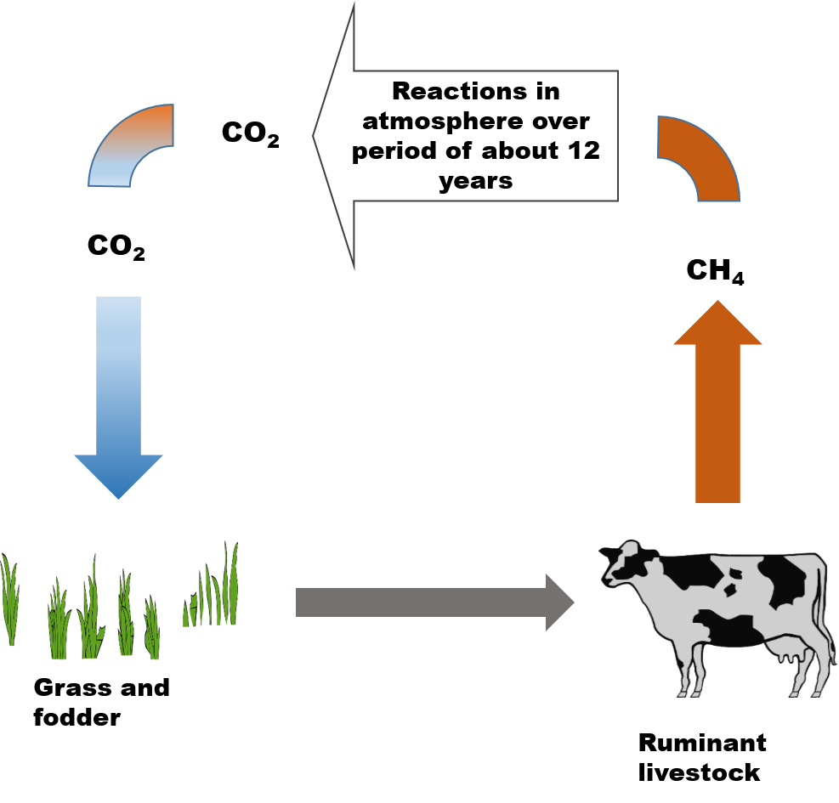
The issue of methane emissions : Cyclical nature of ruminant emissions

Slide 19
Comparing CH₄ and CO₂
Q: How to compare the two different behaviours in studies?
A: The GWP100 metric – CO₂e – CO₂ equivalent
Attempt at explanation follows….

Slide 20
Agricultural greenhouse gas emissions – short-lived and long-lived gases
If nothing changes:
Atmospheric CO₂ content
Time
Atmospheric CH₄ content
CO₂e emissions
Time
Time

Slide 21
Agricultural greenhouse gas emissions – short-lived and long-lived gases
If emissions reducing:
Atmospheric CO₂ content
Time
Atmospheric CH₄ content
CO₂e emissions
Time
Time
Notes:
Pie chart from Philip Oliver’s presentation ‘Food Farming for U3A’ – Feb 2023

Slide 22
Livestock trends and global temperature impact
Global situation: Whilst the human population grows 1% per year the livestock population is growing 2.4%
But….
Atmospheric Methane content due to UK cattle
Dairy
1980
Beef
Atmospheric CH₄ content
2020
Time
ie ‘Net negative’ global warming effect
Notes:
Global situation - from Philip Oliver’s presentation ‘Food Farming for U3A’ – Feb 2023

Slide 23
Implications
Almost all studies use the GWP100 metric for calculating methane effects
Eg: BBC News item 20th July 2023: Eating less meat 'like taking 8m cars off road‘ – from Livestock Environment And People (LEAP) project – Nature Foods, lead author: Peter Scarborough, professor of population health, Oxford Martin School
Food Climate Research Network report: Grazed and confused?, Food Climate Research Network (Lead institution: Oxford University Environmental Change Institute), 2017

Slide 24
What should I do?….
Eat less but better meat…
- but focus reduction on chicken and pork, rather than beef and lamb
Grow more of my own fruit and veg?
Attempt to promote a better treatment of methane effects

Slide 25
Letters re Methane and Climate Change
Date | Recipient | Ack? | Response
23/4/19 | T Lenton, Professor of Climate Change and Earth System Science, Exeter University | ✗ | ✗
6/5/19 | The Times | ✗ | Not published
3/6/19 | Daily Telegraph | ✗ | Not published
3/12/19 | National Farmers’ Union – General Enquiries | ü | Suggested messaging NFU ‘CallFirst’
6/12/19 | NFU CallFirst | ✗
3/2/20 | Chaser to NFU CallFirst |  | Reply 18/2/20
4/2/20 | Chairman, DEFRA Science Advisory Council, Prof Charles Godfray, Oxford University Zoology Dept | ✗ | ✗
28/2/20 | Michelle Cain, Oxford Martin School (author of paper recommended by NFU) |  | Replied 2/3/20

Slide 26
COVID-19 LOCKDOWN FROM 23 MARCH
Date | Recipient | Ack? | Response
2/6/20 | PA to Prof Myles Allen, Professor of Geosystem Science, Oxford University Environmental Change Institute (identified by Michelle Cain) | ✗ | ✗
4/6/20 | Website request to take part in National Food Conversation | ü | Work of Food Strategy Team temporarily paused owing to Covid-19
28/7/20 | Jeremy Hunt, MP for my constituency, SW Surrey | ü | Email being forwarded to Environment Secretary
 | (forwarded to Environment Secretary) | ✗ | ✗
14/9/20 | Chaser to Jeremy Hunt re above | ✗ | ✗
2/11/20 | Further chaser to Jeremy Hunt re above | ✗ | ✗
3/2/21 | Final note to Jeremy Hunt giving up hope of response from Envir’t Secretary | ü | Letter from George Eustace dated 4 Jan rec’d 5 Feb
7/9/20 | Farnham Herald |  | Published 17/9
October 2020 | Exchange with Colin Shearn, local Climate Activist |  | Several messages back and forth. My argument not accepted
14/11/20 | BBC Farming Today | ü | ✗
28/11/20 | Harriet Bartlett, Postgrad Student in Cambridge University Zoology Dept (featured in Farming Today broadcast) | ✗ | ✗
1/12/20 | Hardcopy letter to Minette Batters, President, National Farmers Union |  | Reply by both email and letter 8/12/20
9/12/20 | Follow-up email to Gill Thompson of NFU, with suggested amendment to greenhouse gas emission diagram | ü | Acknowledged and forwarded to Ms Batters and other colleagues

Slide 27
Date | Recipient | Ack? | Response
3/2/21 | Email to defra.helpline@defra.gov.uk | ü | ✗ so follow-up sent 5/4
1/3/21 | Email to Bill Gates at Bill and Melinda Gates foundation | ✗ | ✗
22/3/21 | 500-character message to Bill and Melinda Gates foundation | ✗ | ✗
5/4/21 | Follow-up to defra.helpline@defra.gov.uk | ü | ✗
3/6/21 | Email to Jeremy Hunt requesting COP26 be used to insist on use of GWP* in greenhouse gas comparison studies | ✗ Chased 15/6; then ü | Reply received 5 Aug 2021 from Alok Sharma via Jeremy Hunt’s office
3/6/21 | Email to Nature Friendly Farming Network | ✗ | ✗
8/6/22 | Email to Jeremy Hunt requesting he attend Nature Friendly Farming’s drop-in event at Parliament | ✗ | ✗ Maybe felt no explicit ack. req’d
18/7/22 | Email to Dr Giles Yeo, Research Associate at Cambridge and presenter of BBC Radio 4 programme ‘Plant-based Promises’ | ✗ | ✗
8/11/22 | Email to Nature Friendly Farming Network re report ‘Rethink Food – a Plan for Action’ | ü | ✗
14/2/23 | Email to Yeo Valley following their Carbon Footprint Accreditation initiative | ü | Brief reply received 31/3

