Slide 1
Flower Photography
And a few Hints and Tips…..

Slide 2
Requirements:
Camera
Light
Subject

Slide 3
CAMERA
Any camera will do…….but
Range of lenses helps…..
Macro 1:1 ideal for close ups
Zoom telephoto useful also
Ability to adjust ISO Aperture and Speed useful

Slide 4
SUBJECT
See something you like?
Take your time and look at it from all aspects…..
Think separation, background, lighting, distractions – eg bright background objects
Juxta positioning

Slide 5
LIGHT
Use what light you have…………..
Bright sunlight is generally not good
A cloudy day is usually better
Overhead sun causes colours to either be in shadow or blown out
Use reflector or flash or LED light to brighten shadows
If sunny a low sun is good – Golden Hour
Shooting into the light

Slide 6
POST-PROCESSING
Software
Photoshop
Workflow
RAW
Noise Reduction / Sharpening / Plugins – Topaz
Landscape / Portrait – size ratios
To ‘clean’ or not to clean

Slide 7
ISSUES
Wind
Tripod or not? – live view and manual focus
Focus
DOF
Camera shake
Background
Bokeh – background and foreground
More than one? – odd numbers are more pleasing…
Water droplets
Dead flowers
Flower movement
Coloured vignette

Slide 8
ISSUES 2
Starburst from sun – aperture and flare
B&W
Exposure and blown colours - underexpose
Shoot plant labels

Slide 9
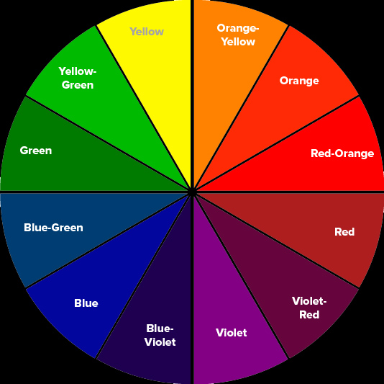
GARDEN PHOTOGRAPHY
Composition ‘Rules’ – rule of thirds, Fibonacci spiral
(- 1.618:1 – pfi grid) + leading lines, diagonals,
triangles, negative space or fill frame, framing.
symmetry, etc
Light
Layer your photos
Colours – complementary or analogous colours
Keep photo simple
Avoid too much sky and grass
HDR?
Rain / puddles / water

